Slide 1
Retraining is Not a Corrective Action Digging Deeper when Investigating the Human Cause of Incidents
Ryan Ward, CHST, CIT American Society of Safety Professionals Professional Safety Journal, 70(1) January 2025
Bethany Ryan University of Idaho
PSYC 562: Advanced Human Factors
Professor Roger Lew February 05, 2025

Slide 2

Human and Organizational Performance (HOP)
….an operating philosophy that tunes OSH professionals’ focus on both the human factors and organizational causes of incidents
(1) Human Error is Normal.
(2) Blame Fixes Nothing.
(3) Learning is Vital.
(4) Context Drives Behaviors.
(5) How you Respond to Failure Matters.
Five principles:

Slide 3
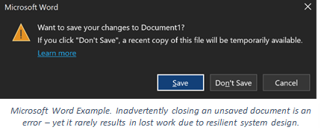
Human Error is Normal
To err is human.
All people, regardless of skills and ability, have the potential to make mistakes, and this is completely normal.
Notes:
People are human, and humans make mistakes. Recognizing that people make mistakes is simply acknowledging that human error is normal. We forget things. We are sometimes inattentive. We’re human! While error is not desirable, we can build resilient systems that allow for us to make errors in in a safe way. Being one error away from a serious incident or accident is a system problem, not a human problem.

Slide 4
Blame fixes Nothing.
You can either blame and punish or learn and improve; you cannot do both.
The moment blame is placed on the employee, their willingness to listen, learn and improve is greatly diminished.
Notes:
Blame is part of our everyday life. It permeates our media. When things go wrong, there is an incessant drive to name who did something wrong – whose fault it is. Humans have a tendency to want simple explanations, and wanting someone to blame is anormal, natural human response…but it is not very helpful. Blame actually tends tomake processes worse! It hinders the learning necessary to create resilient, reliable systems. Those directly involved in processes, both when things go right and when things go wrong, are knowledgeable experts with a critical role in creating systems that produce better outcomes for themselves and others. By avoiding blame, we enable better learning.

Slide 5


Coolant Mix-Up

Slide 6
Human Error
Individual counseled and/or disciplined, or changes made without input
Reduced Trust
Less Communication
Management less aware of jobsite conditions
Latent Organizational Weaknesses persist
More flawed defenses and error precursors
Blame Cycle
Be hard on the process not the person

Slide 7
Common Assumption worth Challenging
People make errors because they…
Don’t Know
⇨Train
<10% errors = lack of competence
Don’t Care
⇨Punish
Most people care and are committed to doing a good job

Slide 8
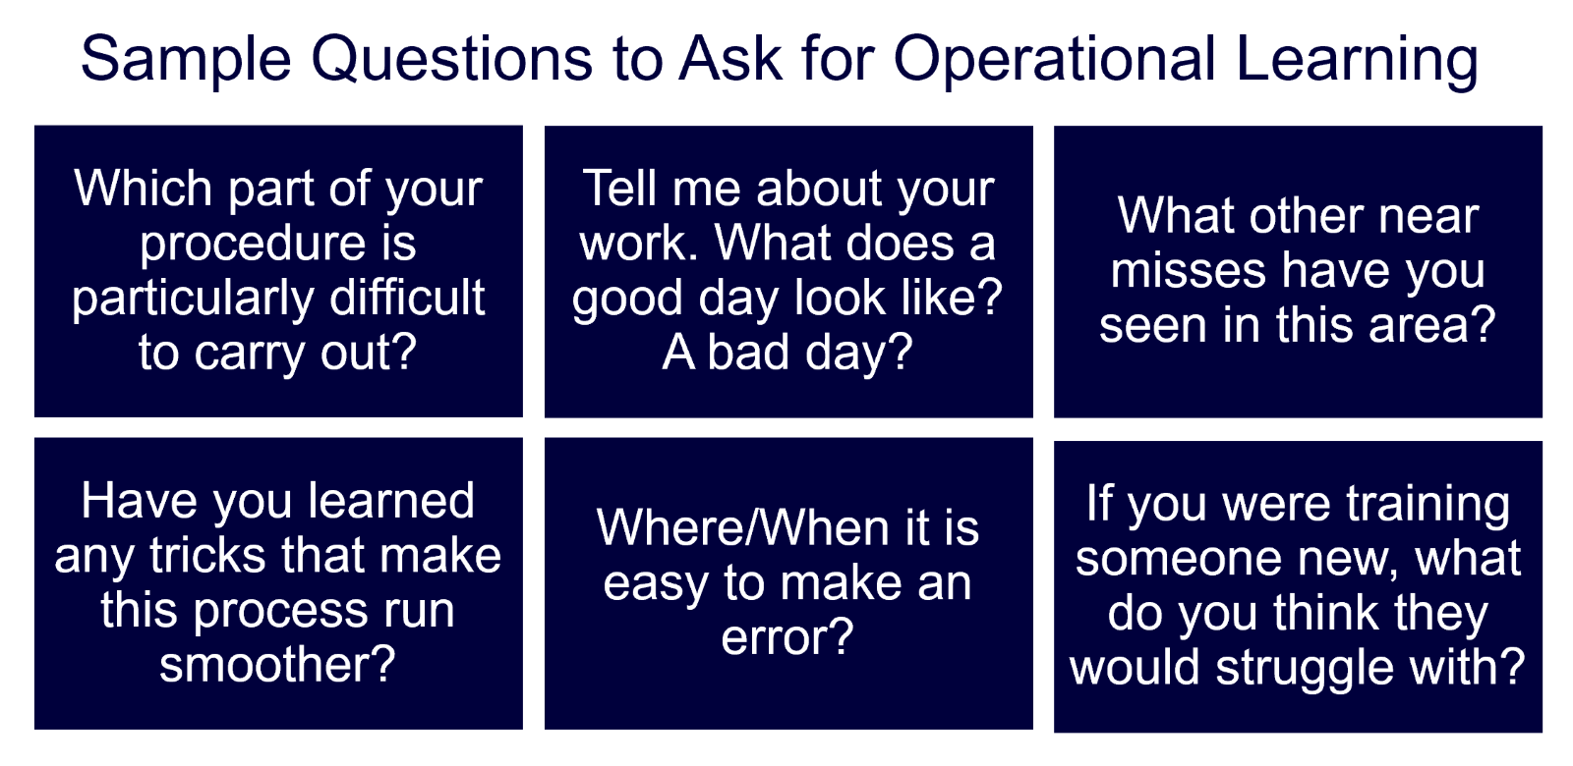
Learning is Vital.
Every incident is an opportunity to learn.
Even the simplest of incidents holds the potential for great information if we are willing to learn.
Notes:
Traditional investigation methods often result in similar corrective actions over and overagain, such as stand downs, retraining, and discipline. In order to identify improvementsthat can notably enhance our performance, we need to learn from the actual workbeing done at the genba. By understanding the "good, bad, and ugly" aspects of howwork is truly performed, we can better allocate our resources and efforts to reduceoperator struggles and improve process stability.If we don't understand how a person’s action —or choice not to act— was logicalbased on the information and conditions they had at the time, we should continueasking questions and learning until we do!Our next touchpoint will highlight the key principle of this series: our response matters!For questions on Human Factors training and concepts or for support for your Kaizen orValue Stream Mapping please email us at: human_factors_ask_an_expert@ge.com125%

Slide 9
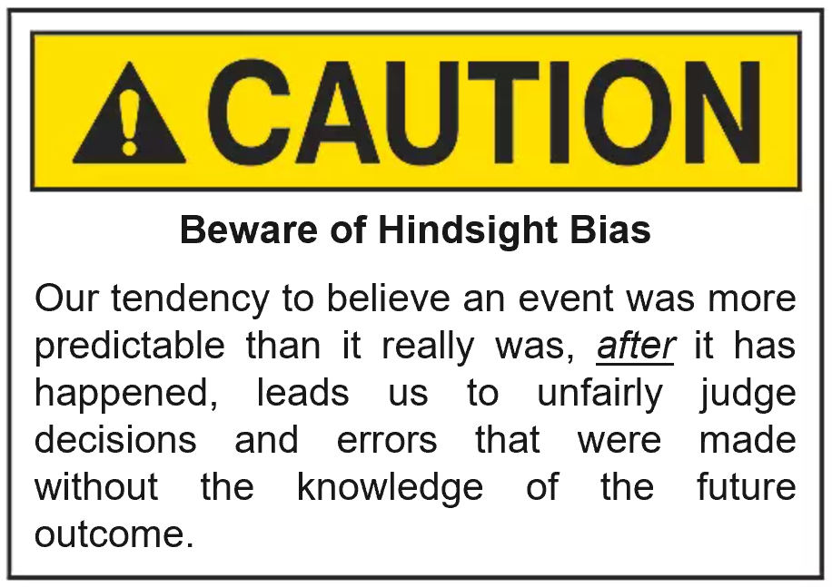
Context Drives Behavior.
It is far too easy to judge.
By looking at the incident through the employee’s eyes at the time of the incident, we stand to gain valuable information about the influences and variables that led to the employee’s actions.
Notes:
s humans, we strive to be rational beings. People tend to make decisions that make sense at the time and in the context that they are made in. We don’t go to work with the intention to make errors to hurt ourselves or damage our products or equipment. By aiming to empathize and be curious, we can understand why a person did what they did after an undesirable event occurs. It probably made sense at the time. We should remember rthat the unexpected event had not yet occurred, and was therefore unknown, when the action was made. If it were, the person would almost certainly have done something differently to try to avoid it! Human error is usually a consequence of a system – not the cause of an event.

Slide 10
Workers don’t cause failures.
Worker’s “trigger” latent conditions that lie dormant in our organizations.
Errors are consequences not causes.

Slide 11

Employee failed to use the coolant called for in work instructions. Failure to follow work instructions/violation of work instructions.
Employee did not care enough to pay attention. Discipline employee.
Traditional Investigation: views human error as the cause of the event

Slide 12

Employee inadvertently used incorrect coolant, in the middle of the night on 3rd shift, which came in identical pink drums. Color code drums to ease discernment.
Further learning with employee uncovered that use of the two different coolants was an unnecessary and excessive administrative burden.
Event Learning with Human Factors Lens:
views human error as a consequence of the system
Significant difference in response, following significant difference in problem definition.

Slide 13
“If you define the problem correctly, you almost have the solution.” (Steve Jobs)

Slide 14
How you Respond to Failure Matters.
If employees feel that management is and only investigating to find out who should be fired, this develops a culture of fear.
If the employees can speak without fear because they know that management’s priority is to learn from mistakes and prevent them from recurring, this builds a culture of interdependent safety.
Notes:
Often, when faced with the stressful task of addressing an undesirable event, we may quickly react rather than thoughtfully respond. Our immediate response following an event is crucial.
By intentionally responding with SQDC (safety, quality, delivery, and cost – in that order!) at the forefront, we prioritize valuable learning opportunities and steer clear of knee-jerk reactions driven by biases and blame. By seeking understanding and leveraging our human factors perspective, we foster more effective improvement actions and cultivate an environment conducive to continuous learning and growth.

Slide 15
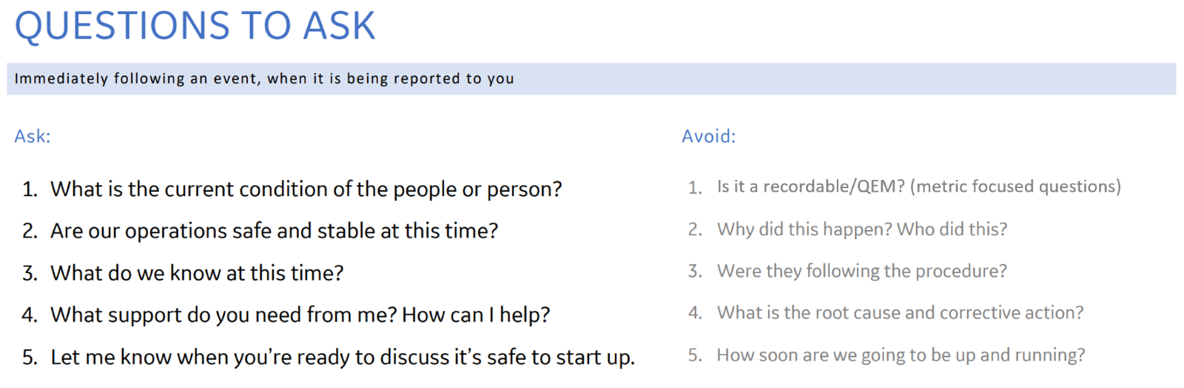

Slide 16
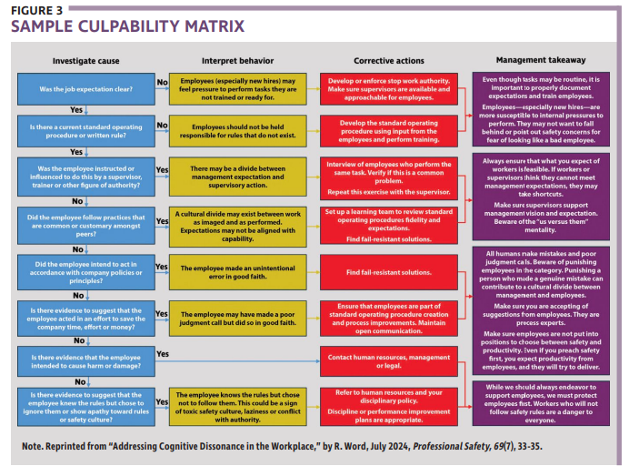

Slide 17
Q7. Did the employee knowingly violate expectations?
Q9. Would a peer have behaved
differently under those or very similar circumstances?
Q11. Does the employee have a history of human performance problems?
Q1. Were the actions intended?
no
no
no
yes
yes
yes
no
no
Q2. Were the consequences intended?
Q8. Were expectations reasonable, available, workable, intelligible, correct and consistently enforced?
Q10. Were there deficiencies in training, selection, assignment or experience?
Q12. Was the performance problem self-reported?
yes
yes
no
no
yes
yes
no
yes
C1. Intention act (not an error)
C6. Possible reckless violation
C7. System- induced violation
C8. Possible negligent error
C9. System induced error
C10. Blameless error with remediation
C11. Blameless error
This was not an error; the behavior is possibly sabotage, malevolent damage, willful violation and disciplinary process is warranted
Q9. Would a peer have behaved differently under very similar circumstances?
Q9. Would a peer have behaved differently under very similar circumstances?
This is an appropriate conclusion if another person (peer) would have foreseen and avoided bringing about the consequence. It suggests more individual culpability than a system-induced error. Corrective action should seek to understand why the individual did not recognize the potential consequence and why he/she believed his/her behavior was appropriate for the situation.
This was an error provoked by the system in which the individual was working. If
there was a deficiency in selection and/or assignment, further analysis should focus on the hiring process.
Deficiencies in training or experience should analyze the training and qualification process for the individual’s
job position. Other parts of the system should also be evaluated for related causes.
This was an error; However, the behavior (or history of this type of behavior) may warrant some form of remediation to correct it.
Determining the performance mode of the error skill-, rule- or knowledge-based) will serve to indicate the appropriate training or form of remediation needed.
Analysis of organizational processes and management/supervisory practices should also be conducted.
This was an error; the individual should not be individually blamed. Analysis of
organizational processes and management/ supervisory practices should be conducted to identify conditions that
provoked the error and weaknesses in the defenses that did not mitigate the consequences of the error.
YES. This was a
reckless violation. Invoking the
organization’s disciplinary
process is warranted.
NO. This was not a reckless violation. Conclusion: This must have been system-induced. Use causal analysis to determine systemic/ organizational causes that prompted or influenced the violation.
YES. Invoking the
organization’s disciplinary
process is warranted, but it is still required to evaluate relevant organizational processes and
related management / supervisory practices.
NO. Causal analysis should be used to determine the type of violation (routine, optimizing or necessary) and the systemic causes that prompted, or influenced the violation.
Adapted from Andy Hobbs, 2008. Human Performance Culpability

Slide 18
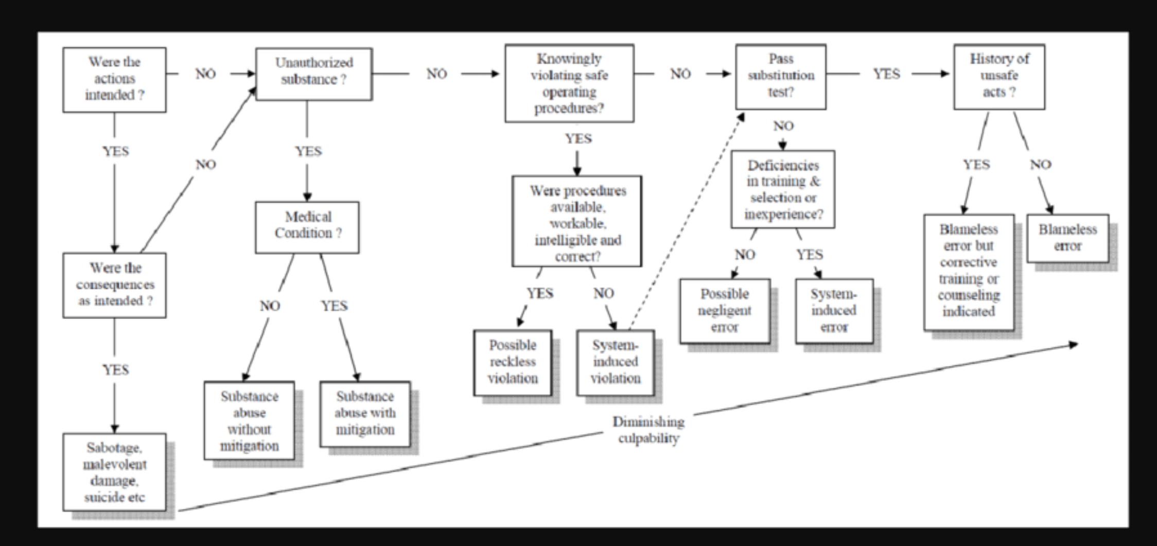
Human Performance Culpability Decision Tree (Reason, 1997)

Slide 19

The word “accountability” comes from “account,” meaning to tell a story.

